Slide 1



Build Interactive Web App with R & Shiny
Part 4 of ShinyApps series
Prepared by : Aep Hidayatuloh
Email : aephidayatuloh.mail@gmail.com
GitHub : https://github.com/aephidayatuloh
RPubs : https://rpubs.com/aephidayatuloh

Slide 2
Publish Shiny App
Deploy And Publish Shiny App

Slide 3

Deploy Shiny Apps
There are two ways to deploy the apps :
Locally | → | you can run the apps on your own local machine (local server) or local area network (no need internet access).
Web | → | deploy your apps to the web hosting. Shinyapps.io is free!

Slide 4
Deploy Your Apps To Web
If you want your Shiny app to be accessible over the web, so that users only need a web browser and internet access.
Shinyapps.io is a platform as a service (PaaS) for hosting Shiny web apps.
Before you get started with shinyapps.io, you will need the latest version of the rsconnect R package,
install.packages("rsconnect")
and Create a shinyapps.io account.

Slide 5
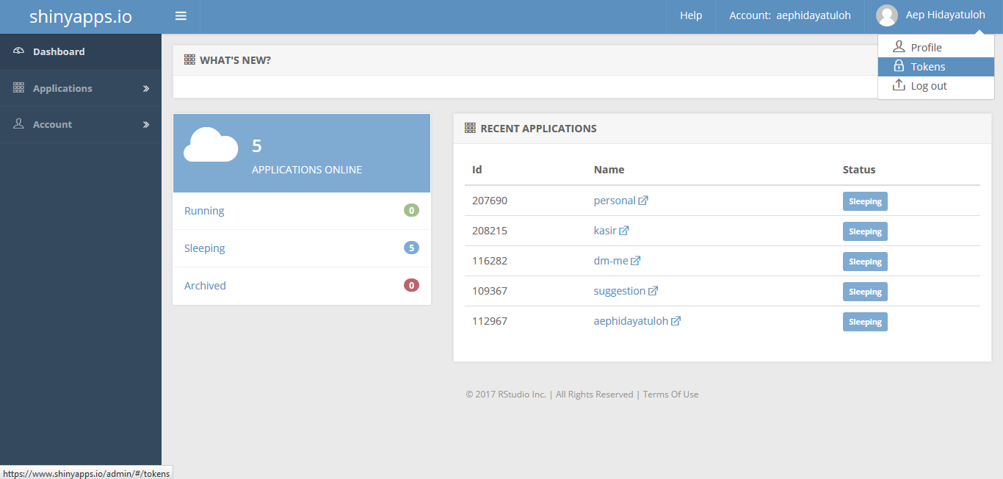
Create shinyapps.io Account
Go to https://www.shinyapps.io and create a new account by sign up or log in if you already have.

Slide 6
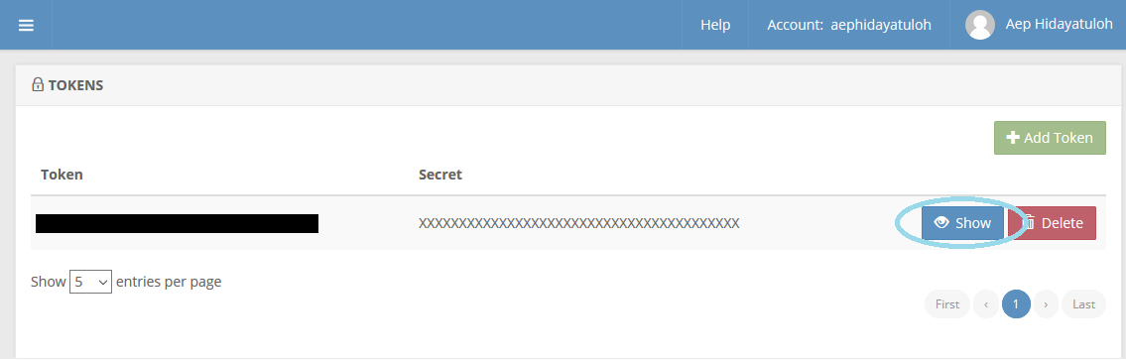
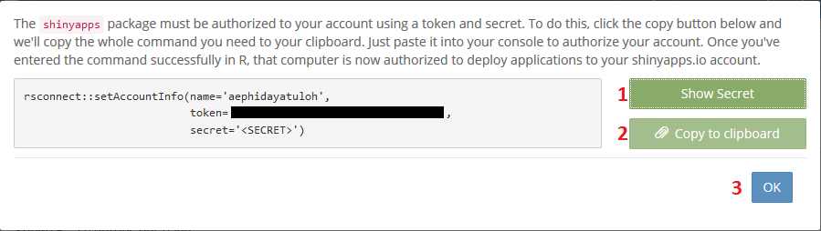
Generate Token
Generate token and copy

Slide 7

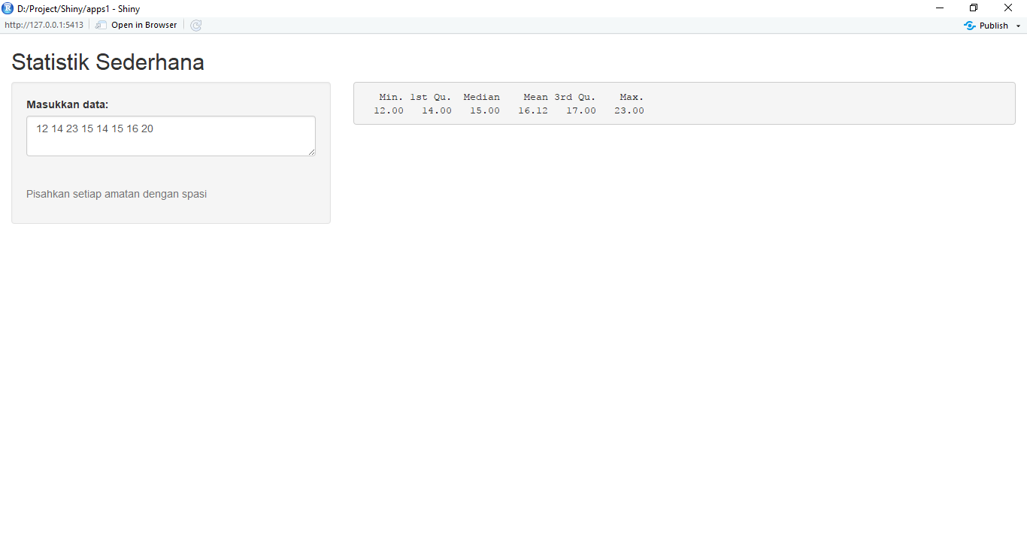

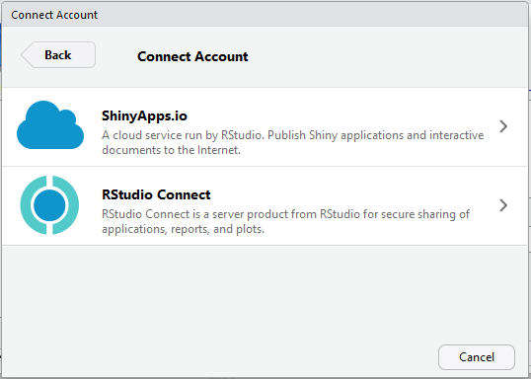
Publish Apps

Slide 8
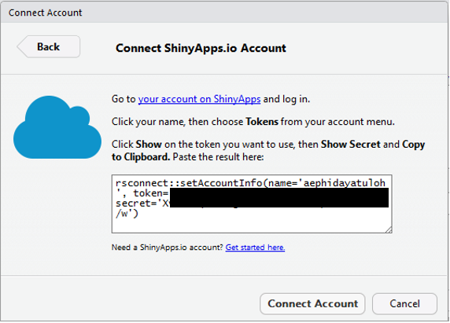
Setting Connection
Copy and Paste the copied token

Slide 9
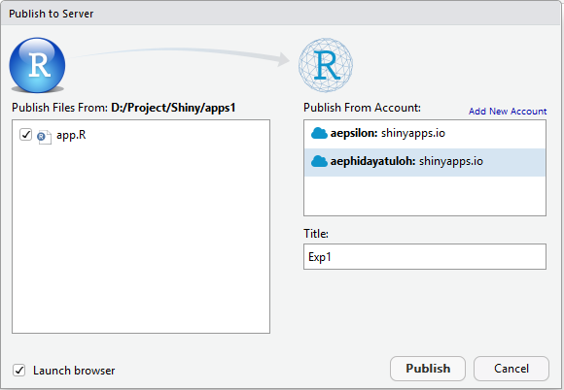
Apps Name
Open the created app: https://aephidayatuloh.shinyapps.io/Exp1

Slide 10


